Slide 1
Engleski jezik struke 3
Sreda, 16.05.2018.

Slide 2
Let’s analyze your summaries….
Divide the text into paragraphs
1 paragraph = 1 section / 1 idea
At the beginning of each paragraph, clearly indicate which part you’re summarizing
e.g. The author introduces the topic by defining the key aspects of…
The following section of the paper overviews….
Pay attention to TOPIC SENTENCES

Slide 3
Focus on research only – do not give definitions or general statements
Make sure you distinguish between the authors’ words and general statements
After writing, always go back and EDIT, cut the clutter, reexamine topic sentences
Focus on METHODOLOGY and RESULTS and be precise about them.
( do not say “ some methods”, “certain results”, or similar)

Slide 4
Use active rather than passive
Avoid phrases with IT
e.g. It is stated / believed / presumed / doubtful / concluded ….
Your summary should be clear to someone who hasn’t read the article
Choose the articles wisely ☺

Slide 5
Some sentences to cut…
In this article, the author addresses a variety of research studies and articles regarding detecting financial fraud using data mining tools, in order to present an overall overview of the topic.
The article overviews a variety of research studies and articles to present the use of data mining tools in financial fraud detection.
For every technique, the author states a brief description and business application of it.
The author briefly describes every technique and its business application.

Slide 6
In their research they have chosen three companies, that are representatives of banking, services and industrial sector, based on five criteria which represent companies’ size and liquidity.
The authors use five criteria related to size and liquidity to choose three companies belonging to different sectors (banking, service and industry).

Slide 7
The main purpose of this research is to provide entrepreneurs with the ability to make the right choices when creating brand building strategies in order to attract investors’ funding and ensure financing on an ongoing basis.
This research aims to enable entrepreneurs to choose the best/appropriate brand building strategies to attract investors and ensure ongoing financing.

Slide 8
In a report by EUANIS it is elaborated that….
An EUANIS report elaborates that…..

Slide 9
Next step…
TURN YOUR SUMMARIES INTO ANNOTATIONS
P. 23

Slide 10
Annotated bibliography
- An organized list of citations to journal articles
- Each citation is followed by a brief descriptive and evaluative paragraph, the annotation.
- The purpose of the annotation is to inform the reader of the relevance, accuracy, and quality of the sources cited.

Slide 11
Purpose of our annotated bibliography
Provide a literature review on a particular subject
Help to formulate a presentation topic on a subject

Slide 12
Each annotation should contain….
  The purpose of the article
  A summary of its content
  The intended audience
  Any special or unique features about the article
  The strengths, weaknesses or biases in the article
  Comments on language and style of the article

Slide 13
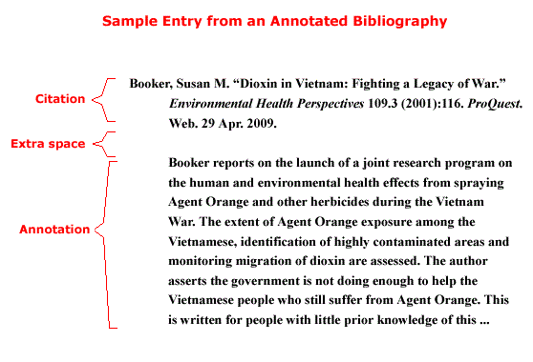

Slide 14
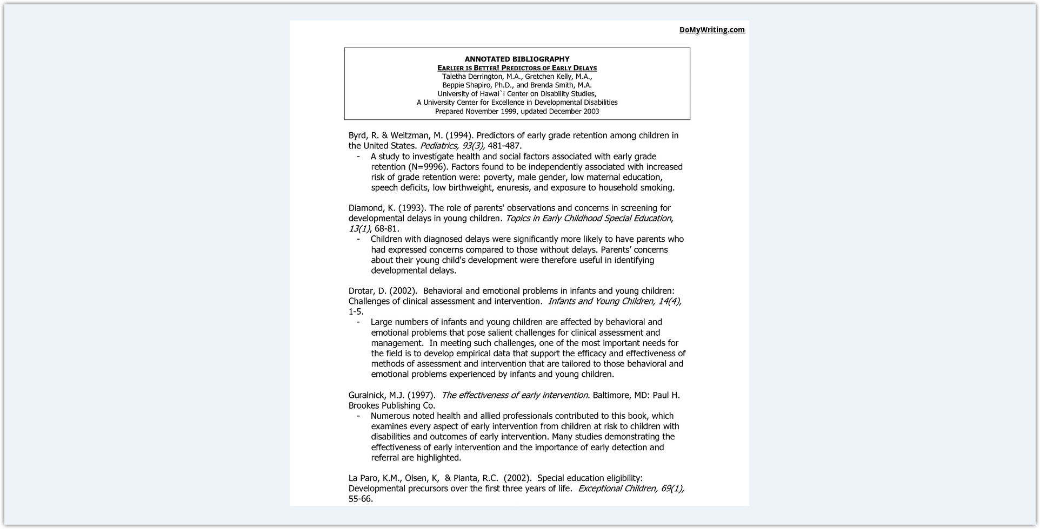

Slide 15
timeline…
Optional:
1/04/2019 – 2nd annotation (summary)
8/04/2019 - 3rd annotation
22/04/2019 – 4th annotation
Mandatory:
6/05/2019 – annotated bibliographies (with 4 annotations)
13, 20, 27/ 05/2019 – presentations

Slide 16
Pages 64-67, 80 in additional papers
FOCUS:
Understanding and describing figures and tables in academic writing (speaking and writing practice)

